Slide 1
DIGITAL IDENTITY AND ENGAGEMENT
DIGITAL HUMANITIES

Slide 2
DIGITAL IDENTITY – DEFINITION
A digital identity is an online or networked identity adopted or claimed in cyberspace by an individual, organization, or electronic device.
These users may also project more than one digital identity through multiple communities.
In terms of digital identity management, key areas of concern are security and privacy.

Slide 3
DIGITAL IDENTITY – CHARACTERISTICS
Like its human counterpart, a digital identity is comprised of characteristics, or data attributes, such as the following:
Username and password
Online search activities, like electronic transactions
Date of birth
Social security number
Medical history
Purchasing history or behavior
A digital identity is linked to one or more digital identifiers, like an email address, URL or domain name. Because identity theft is rampant on the Web, digital identity authentication and validation measures are critical to ensuring Web and network infrastructure security in the public and private sectors.

Slide 4
DIGITAL CITIZENSHIP
Citizenship, or the participation and engagement of individuals within communities, is a cornerstone of democratic society.
In the 21st century, increasing access to, and the proliferation of, digital tools has allowed new forms of social, political, cultural, and global connectivity.
This connectedness has given rise to new forms of community discourse, often defined collectively as digital citizenship.

Slide 5
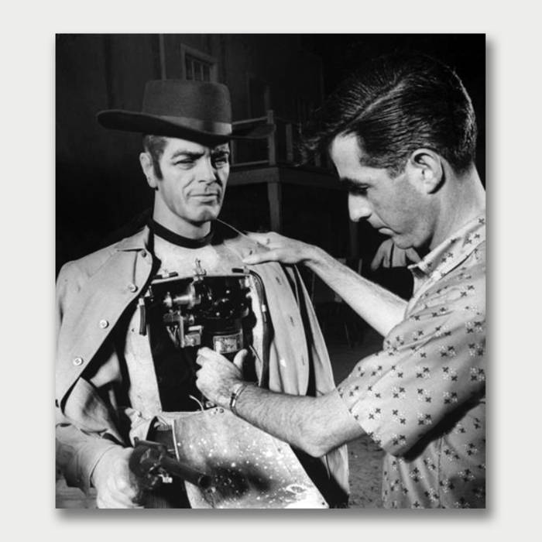
DIGITAL ERA – THE WILD WEST
Are we still in the Wild West era of the Digital Age?
What are some of the dangers?
What are some of the benefits?
Who benefits the most?
Is the fun gone?

Slide 6
DIGITAL IDENTITY IN THE HIRING PROCESS
Employers and recruiters increasingly use social media, such as LinkedIn, and search engines, such as Google, to learn more about job seekers and to eliminate potential candidates based on posted information that might be deemed inappropriate.
In a poll conducted by Harris Poll on behalf of CareerBuilder (2014), 43% of hiring managers and human resource workers surveyed said they search for information and photos posted by job seekers, and 51% of those employers who look for additional information reported not hiring based on content candidates posted.
Among the reasons employers reported for eliminating candidates were posting indecent photos, indications of drug or alcohol use, and negative comments about previous employers (CareerBuilder, 2014).

Slide 7
LEVERAGING YOUR DIGITAL IDENTITY
There is an on-going shift in the viewpoint of higher education concerning a student’s digital identity. Colleges and universities now recognize the importance of using digital forums and social media as means for cultivating students’ awareness of, and contributions to, digital social discourse.
Leveraging social media in conjunction with the classroom experience (in person or online) helps to set expectations for participating and contributing in meaningful ways. Critical thinking, communication, and problem-solving are among the top skills sought by employers, and now educators believe part of their role is to help students develop awareness of what digital participation means and help them develop a digital identity to demonstrate key skills.
Do you think it should be part of your professor’s role to help you develop your digital identity? Has this been discussed with you before?

Slide 8
ONLINE REPUTATION IN A DIGITALLY ARCHIVED WORLD
Online reputation management is an essential component of digital identity and online participation, because what someone says about himself or herself, and what others say, shows up in his or her online digital footprint.
Because information and photos posted for a few minutes and deleted may still exist on servers or in archives such as the Internet Archive and may never truly disappear (Internet Archive, n.d.; LePore, 2015), there is a need for users of social media and devices such as tablets and smartphones to monitor online contributions.
Reputation management includes having an understanding of what social media sites offer, using search engines to monitor identity, and understanding how privacy and location settings are used (Madden & Smith, 2010; Rainie, Kiesler, Kang, & Madden, 2013).

Slide 9
DIGITAL ELEVATOR SPEECH
Businesses and career sites encourage job candidates to hone their “elevator speeches,” or short statements that quickly sum up the kind of job they want or the jobs they perform.
The concept is that you should be able to describe a function or skill concisely to a stakeholder in the time it takes to ride an elevator.
In the digital world, this holds true as well, and there is no shortage of ways to quickly capture attention through use of short bursts of text, images, video, or a combination of these techniques.
According to the Pew Research Center’s 2014 social media survey, Pinterest, Instagram, and Twitter ranked among the top social media sites after Facebook and LinkedIn (Duggan et al., 2015). Tools such as these make it easy to join conversations, collaborate, and hone visual and digital literacy skills, and they are good starting points for developing a digital identity.

Slide 10
DIGITAL IDENTITY AND PERSONAL BRANDING
Having a personal brand or identity is important for professional advancement (Wetsch, 2012).
While the concept of branding is a term often associated with business and marketing, the idea is applicable across disciplines.
With the proliferation of digital tools, and use of social media across generations, educators in colleges and universities now feel they have a responsibility to help students develop a professionally acceptable digital identity and make contributions as citizens in digitally connected democratic societies.
Educators are now trying to achieve this by working with students to meet employers’ needs by leveraging currently used social media platforms, learning management systems, e-portfolios, and other tools.
Do you believe this should be part of your education at Marist? Does this shift in education change your perception of your digital identity?

Slide 11
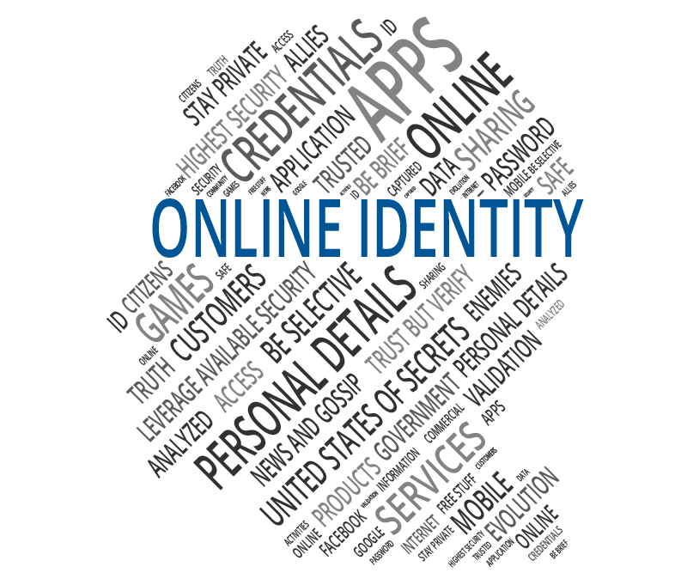
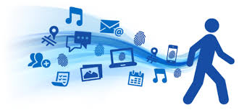
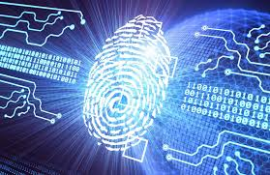
IN-CLASS EXERCISE
Digital Identity Exploration

Slide 12
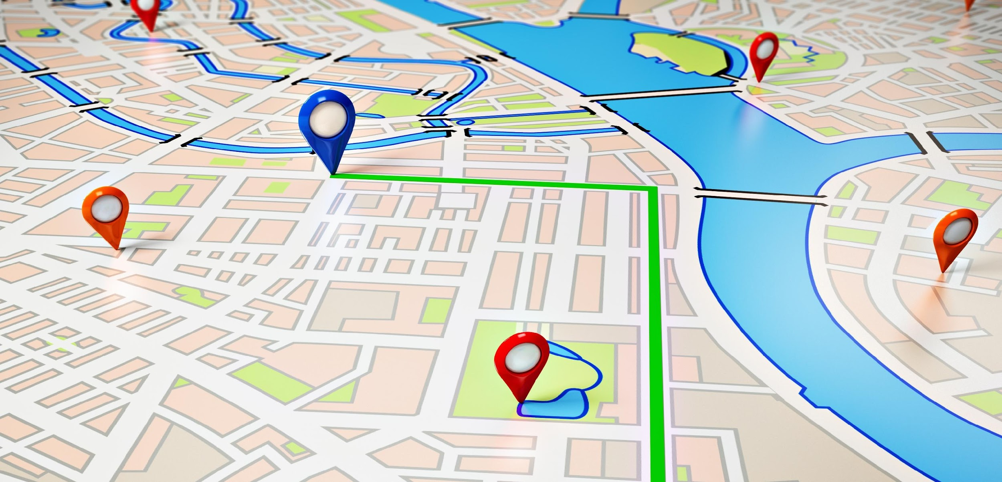
NEXT CLASS…
Mapping Introduction

